Slide 1

Introduction to C Programming
CSI 3130

Slide 2
What is C?
C is a general purpose and structured programming Language.
Considered as a high-level language. (As it allows the programmer to concentrate on the problem at hand and not worry about the machine that the program will be using.)
Originally intended for writing system software.
C was developed at Bell Labs by Dennis Ritchie & Brian Kernighan for the Unix Operating System in the early 1970s.

Slide 3
Features of C Language
Fast and Efficient
Procedural Language
Modularity
Easy to Extend
Features of C
Statically Typed
Portability
General Purpose Language
Rich set of built-in Operators
Libraries with rich functions

Slide 4
Features of C Language (Contd.)
Procedural Language: Step-by-Step predefined instructions are carried out.
Fast and Efficient: FAST because its statically typed language. EFFICIENT because of its runtime performance.
Modularity: Storing the code in form of libraries for further usage.
Statically Typed: Type of variable is checked at compile time but not run time. (The programmer should give a variable a type in each program).
General Purpose Language: Which is used in various applications. (Ex: OS: Windows, Linux, iOS, Android. Databases: PostgreSQL, Oracle, MySQL etc.

Slide 5
Features of C Language (Contd.)
Rich set of built-in Operators: Used in writing complex or simplified C programs. (Unary/Binary/Ternary).
Libraries with Rich Functions: Robust libraries and functions in C help even a beginner coder to code with ease.
Portability: C language is lavishly portable as programs that are written in C language can run and compile on any system with either none or small changes.
Easy to extend: More features and/or operations can be further added to an existing program

Slide 6
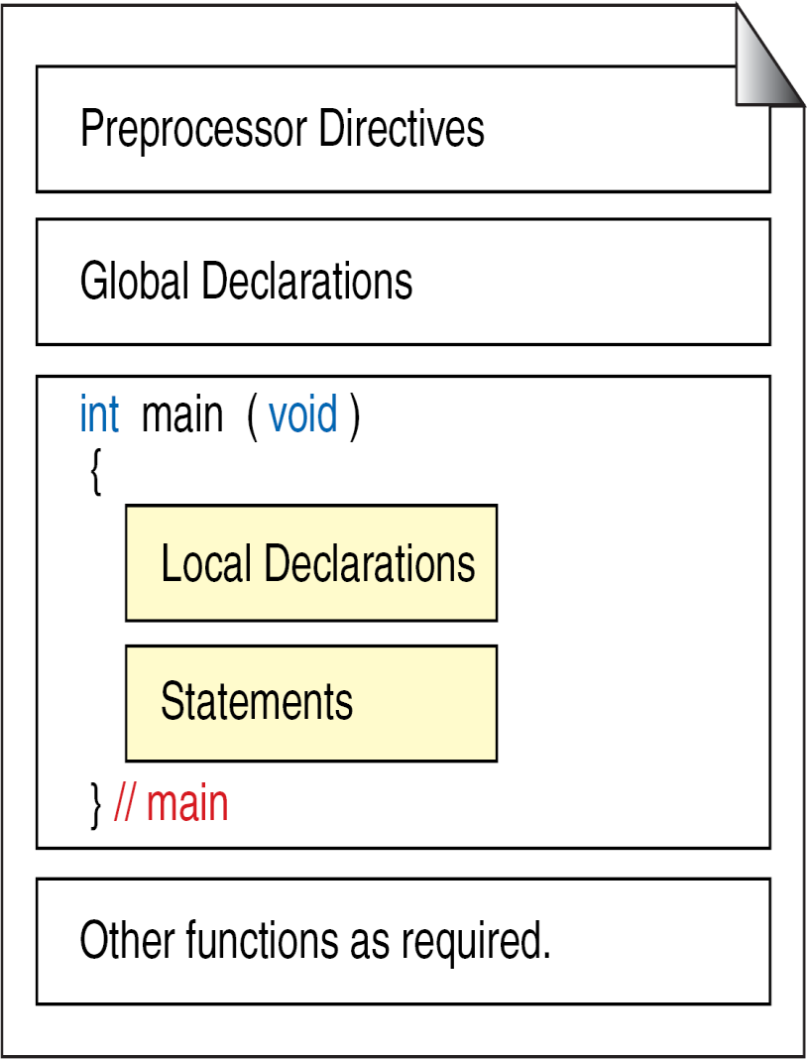
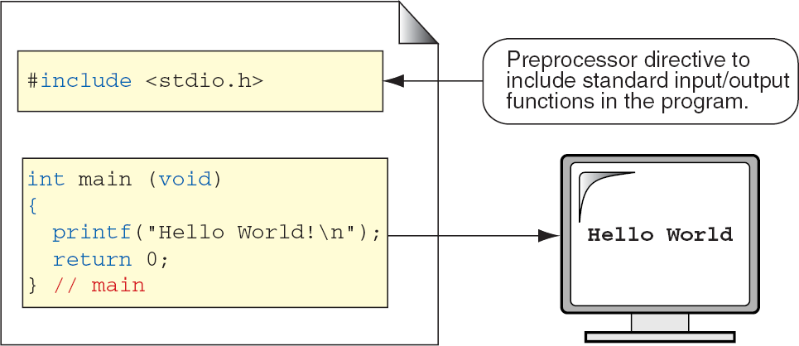
Structure of a C program

Slide 7
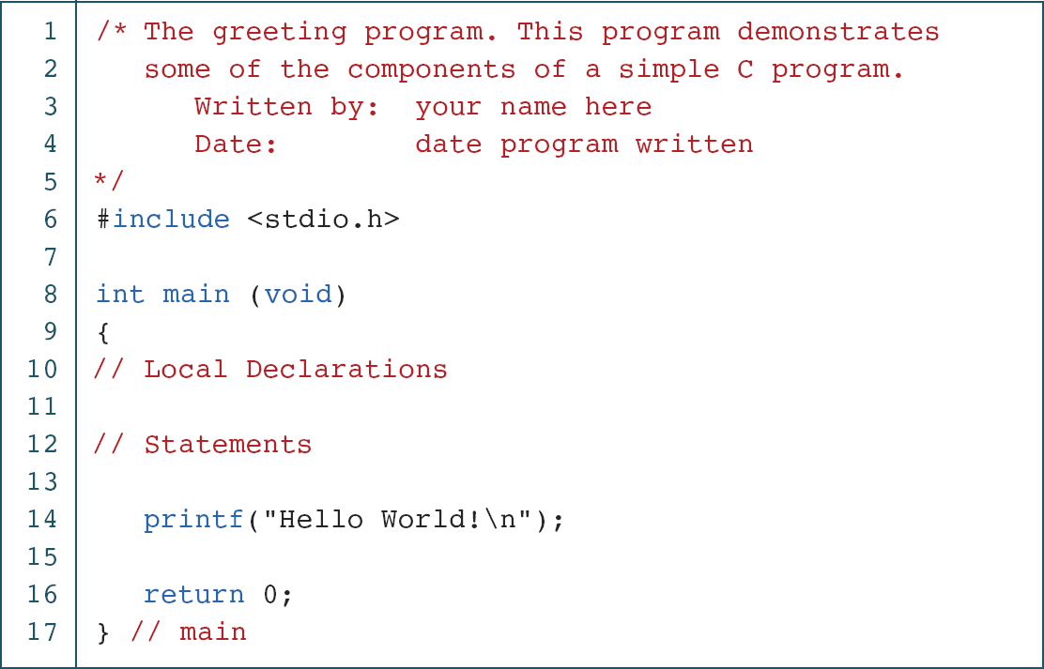
Sample Program

Slide 8
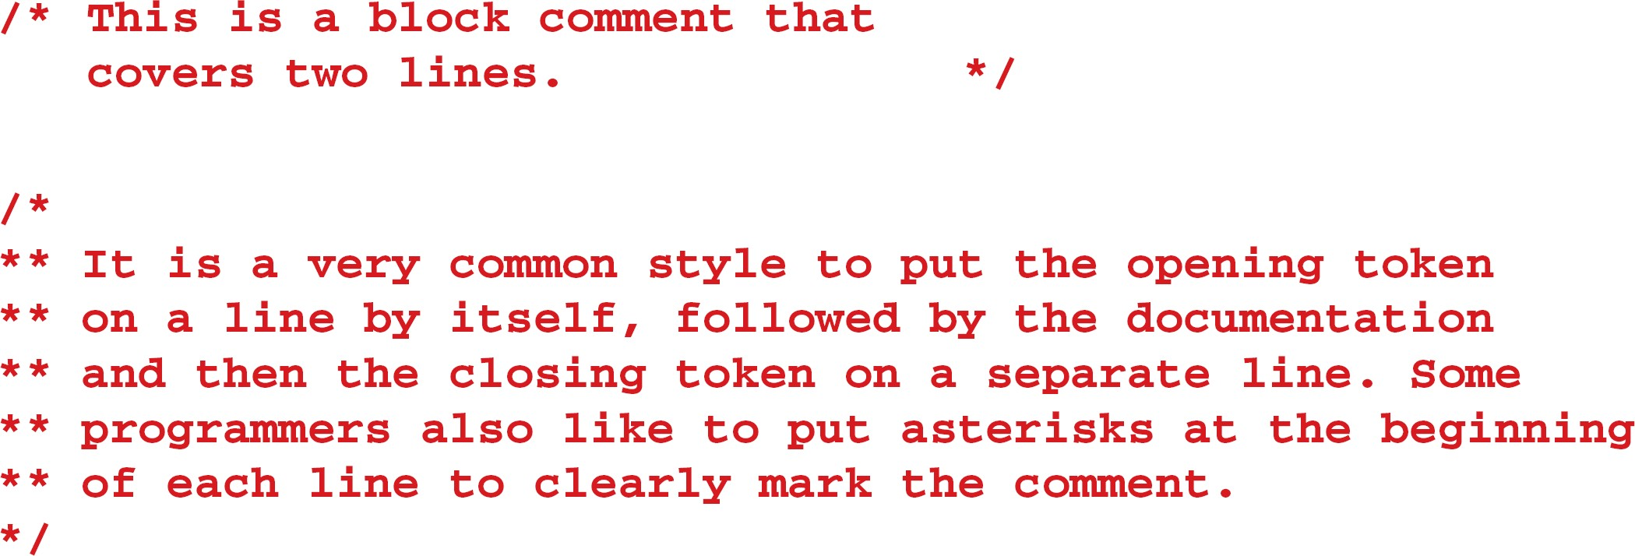
Examples of Block comments

Slide 9
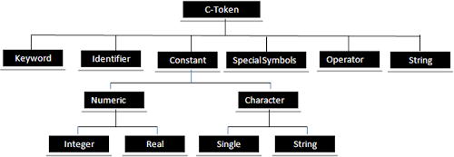
C - Tokens

Slide 10

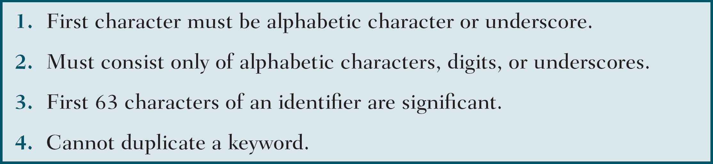
Identifiers
One feature present in all computer languages is the identifier. Identifiers allow us to name data and other objects in the program. Each identified object in the computer is stored at a unique address.
Rules for Identifiers

Slide 11
Notes
An identifier must start with a letter or underscore. It may not have a space or a hyphen.
C is a case-sensitive language.

Slide 12
Examples of Valid and Invalid Names

Slide 13
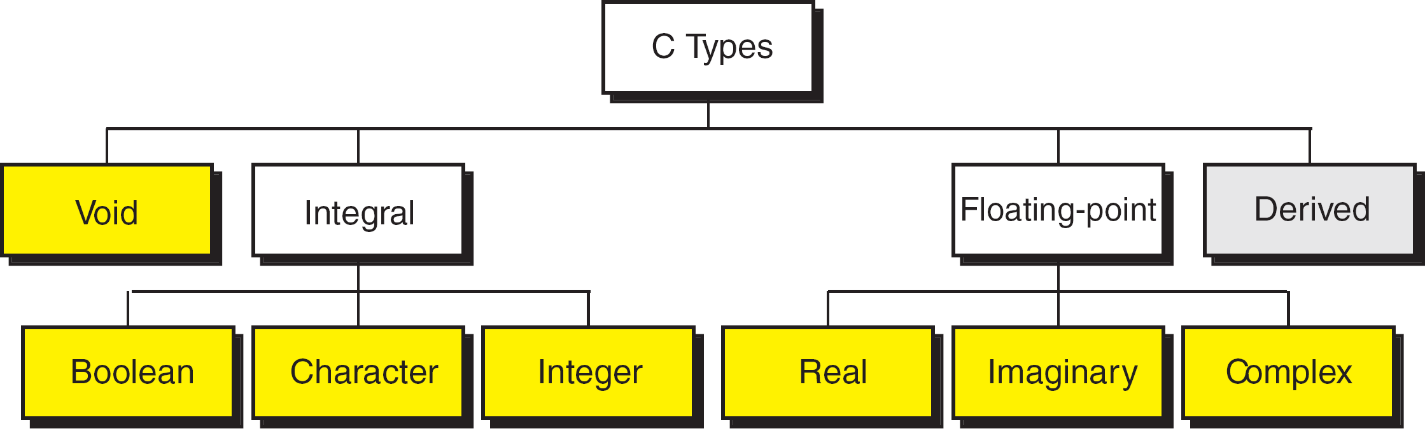
Types
A type defines a set of values and a set of operations that can be applied on those values. The below diagram describes the various C Types.

Slide 14
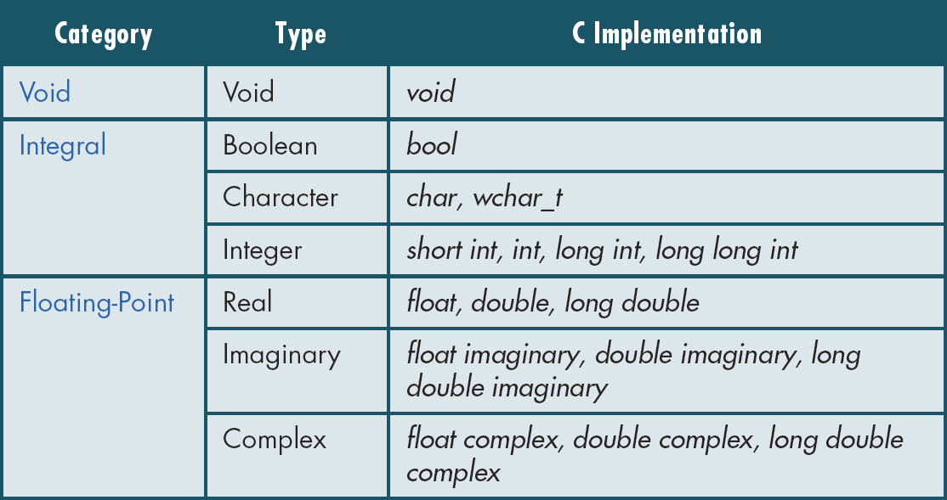
Type Summary

Slide 15
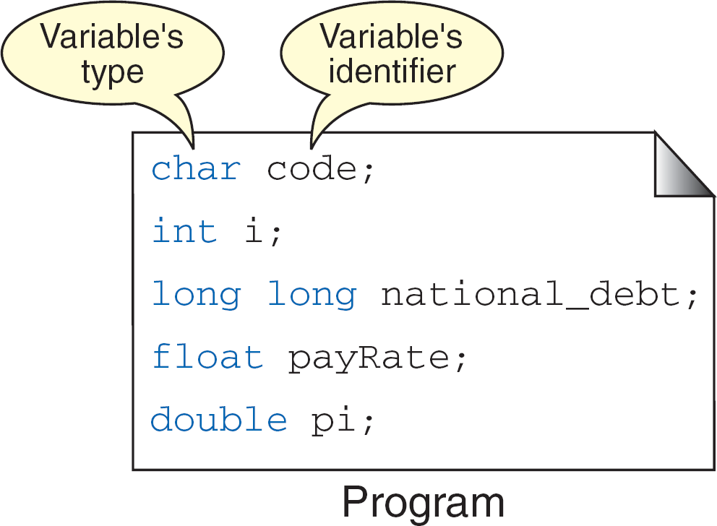
Variables
Variable is nothing but a name given to a storage area that our programs can manipulate.
Each variable has a specific type, which determines the size and layout of the variable's memory.

Slide 16
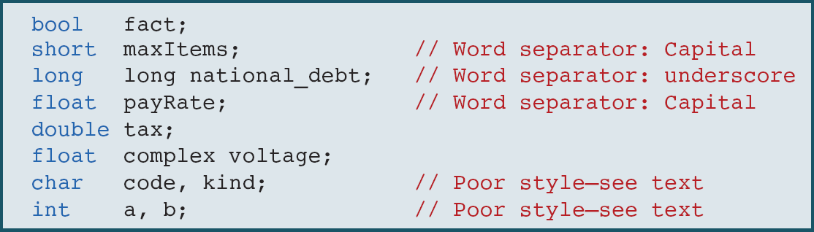
Examples of variables declaration and definitions

Slide 17
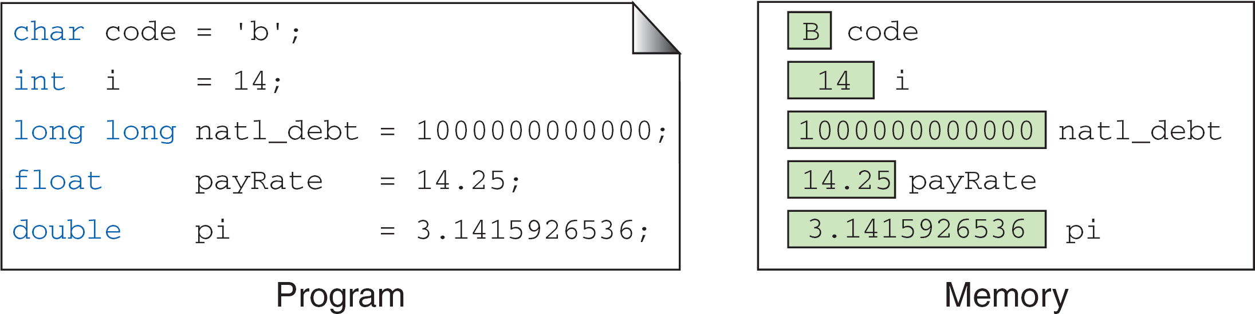
Variable Initialisation
When a variable is defined, it is not initialized. We must initialize any variable requiring prescribed data when the function starts.

Slide 18
Example 1
#include <stdio.h>
// program prints a number of type int int main() {
int number = 4;
printf (“Number is %d”, number); return 0;
}
Output: Number is 4

Slide 19
Example 2
#include <stdio.h> void main() {
int number;
printf("Please enter a number:"); scanf("%d", &number);
printf("Your entered number is: %d", number);
return;
}
Output : Enter a number: 4
Your entered number is: 4

Slide 20
Constants
Constants are data values that cannot be changed during the execution of a program. Like variables, constants have a type. So, constants type might be Boolean, character, integer, real, complex, and string constants.
Constants are treated just like regular variables except that their values cannot be modified after their definition.
To define a constantvariable use ”const” keyword: const int intVal = 10;

Slide 21
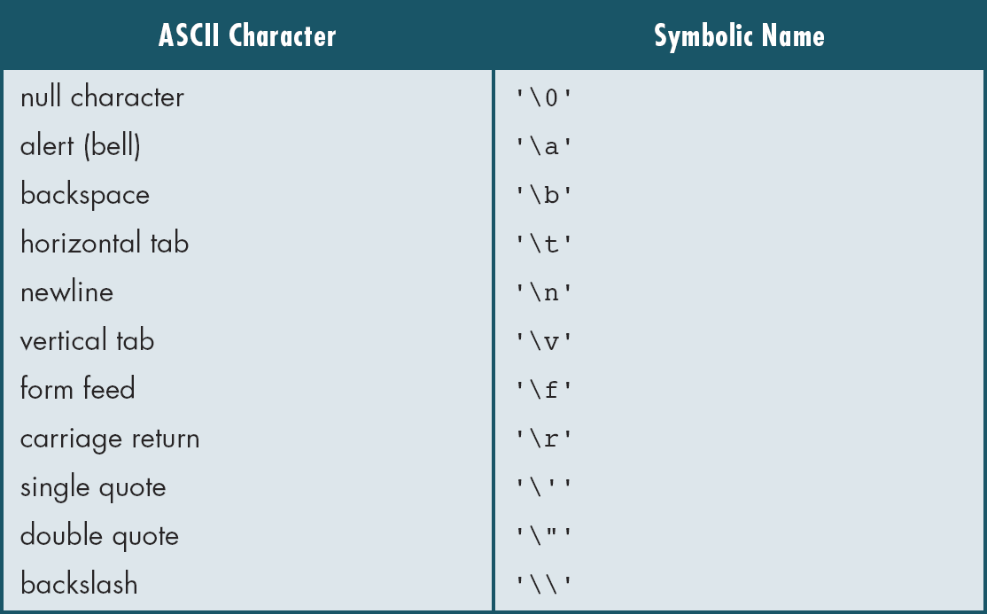
Escape Sequences
As escape sequence is a sequence of characters that does not representitself when used inside a character or string but is translated into another character or a sequence of characters

Slide 22
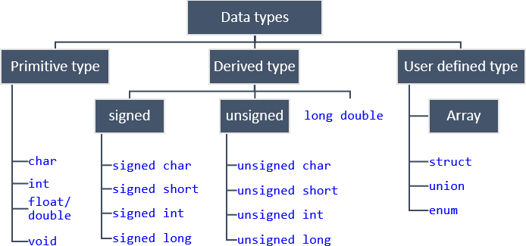
Data types

Slide 23
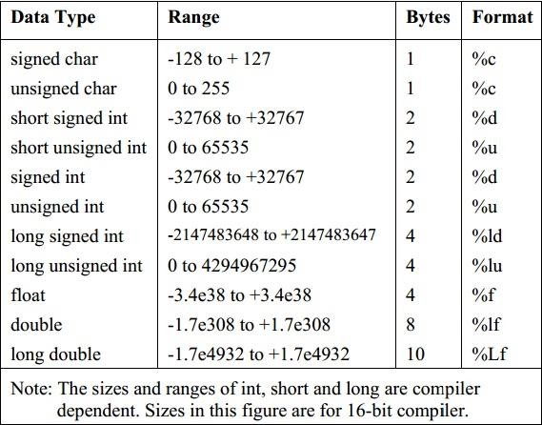
Data types (Contd.)

Slide 24
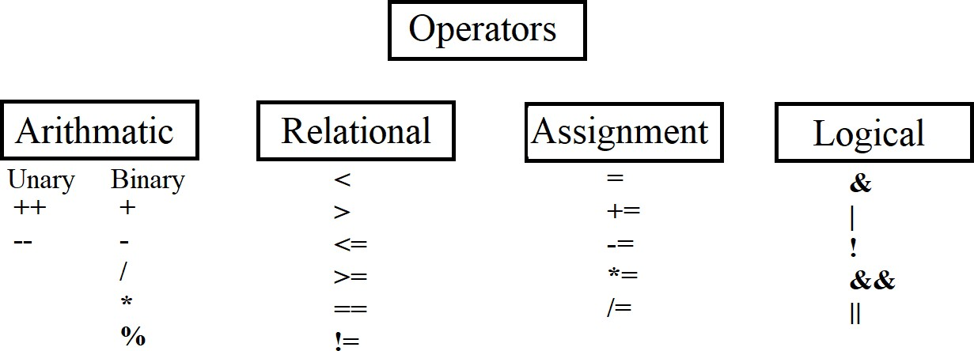
Operators

Slide 25
Operators (Contd.)
Unary Operators
Prefix Increment : ++a
Example:
int a=5;
b=++a; // value of b=6; a=6
Postfix Increment: a++
Example:
int a=5;
b=a++; //value of b=5; a=6

Slide 26
Operators (Contd.)
Binary and Assignment Operators
Modulus (remainder): %
example: 12%5 = 2;
Assignment by addition: +=
example:
int a=4;
a+=1; //(means a=a+1) value of a becomes 5
Can use -, /, *, % also

Slide 27
Operators (Contd.)
Relational Operators
Comparison Operators: <, > , <=, >= , !=, ==, !
example:
int a=4, b=5;
a<b returns a true(non zero number) value.
Bitwise Operators: <<, >>, ~, &, | ,^ .
example
int a=8;
a= a>>1; // value of a becomes 4 (>> is Bitwise Right Shift Operator)

Slide 28
Operators (Contd.)
Logical Operators
Operator | Description | Example
&& | Called Logical AND operator. If both the operands are non- zero, then the condition becomes true. | (A && B) is false.
|| | Called Logical OR Operator. If any of the two operands is non- zero, then the condition becomes true. | (A || B) is true.
! | Called Logical NOT Operator. It is used to reverse the logical state of its operand. If a condition is true, then Logical NOT operator will make it false. | !(A && B) is true.

Slide 29
Operators (Contd.)
Ternary Operator / Conditional Operator
Syntax : condition ? value_if_true : value_if_false
Example: int a = 10, b = 20, c;
c = (a < b) ? a : b;
printf("%d", c);
OUTPUT: 10 ( a < b) --> is set to true. Therefore, c is a.

Slide 30
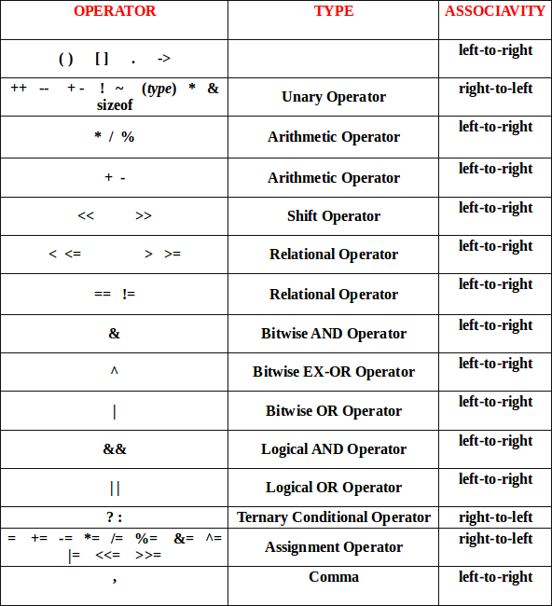
Precedence table

Slide 31
Input / Output
printf (); //used to print to console(screen)
scanf (); //used to take an input from console(user).
example: printf(“%c”, ’a’); scanf(“%d”, &a);
More format specifiers
%c The character format specifier.
%d The integer format specifier.
%i The integer format specifier (same as %d).
%f The floating-point format specifier.
%o The unsigned octal format specifier.
%s The string format specifier.
%u The unsigned integer format specifier.
%x The unsigned hexadecimal format specifier.
%% Outputs a percent sign.

Slide 32
Input / Output
& in scanf.
It is used to access the address of the variable used.
example:
scanf(%d,&a);
we are reading into the address of a.
Data Hierarchy.
example:
int value can be assigned to float not vice-versa.
Type casting (Converting one datatype into another)

Slide 33
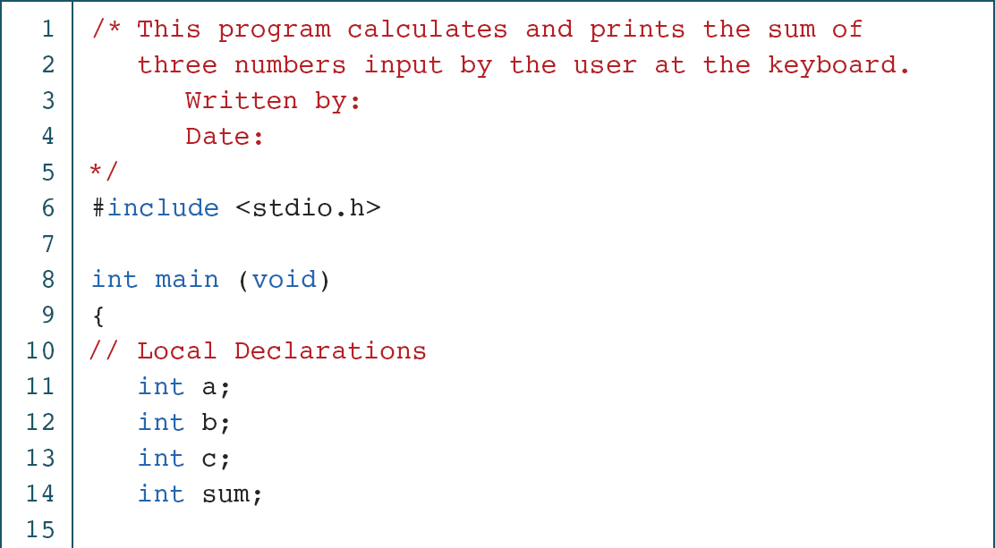
Print sum of 3 numbers

Slide 34
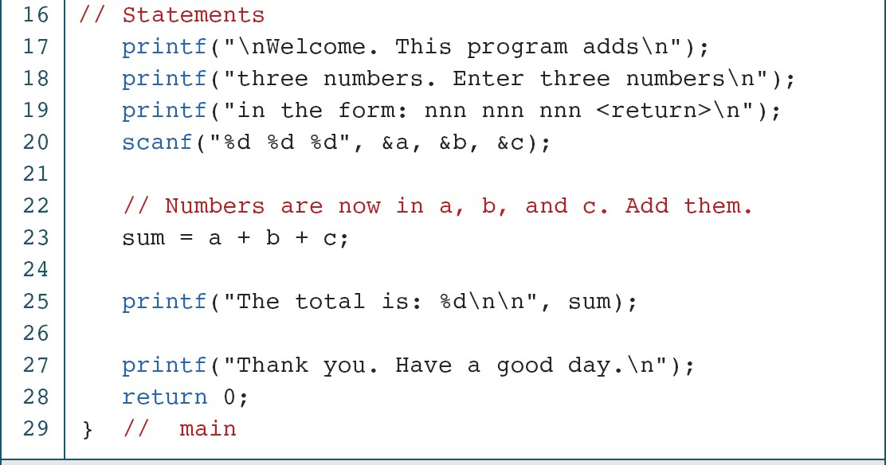
Print sum of 3 numbers (Contd.)

Slide 35
Print sum of 3 numbers (Contd.)

